Slide 1



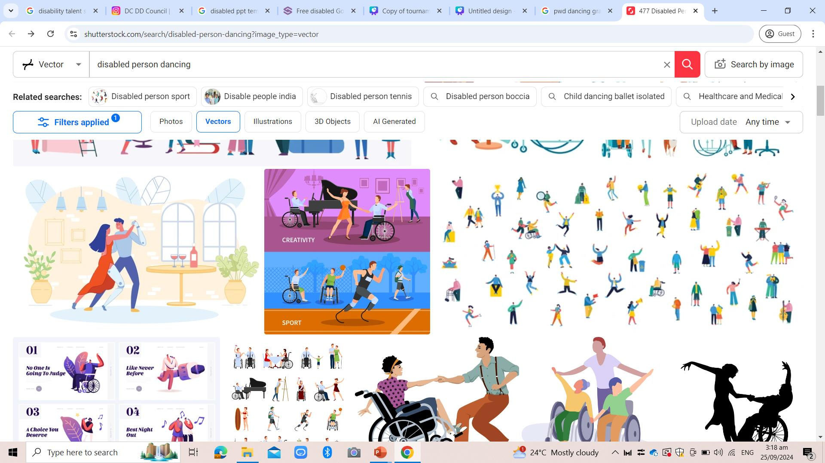


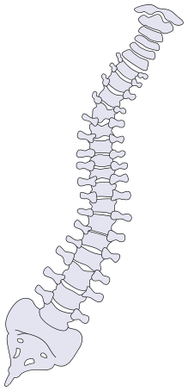















Inclusive Talent Shows
See the
Ability
Presentation by Haron, Hynes Rayyandale M.
BSCE 2A

Slide 2




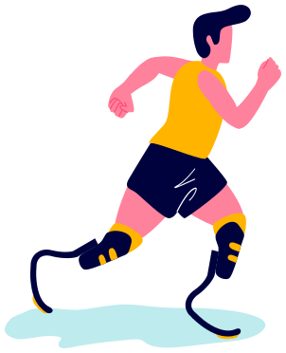
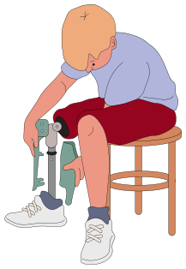



Table of Contents
• Introduction • What • About • Benefits •Call for Action

Slide 3

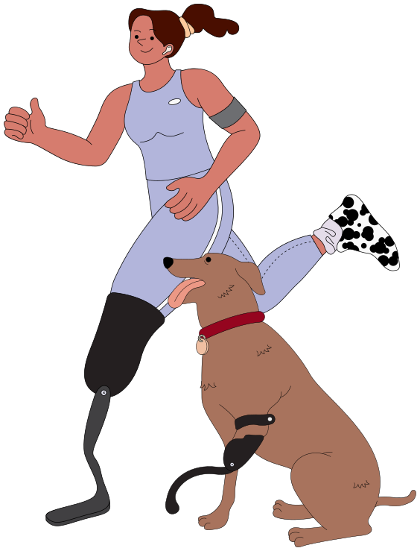
Introduction
The “See the Ability” advocacy highlights the strengths and talents of individuals with disabilities. It creates an inclusive platform that shifts the focus away from limitations, encouraging the community to recognize and celebrate the abilities of everyone.
The goal is to empower PWDs to lead fulfilling lives, achieve their goals, and make meaningful contributions to society.

Slide 4



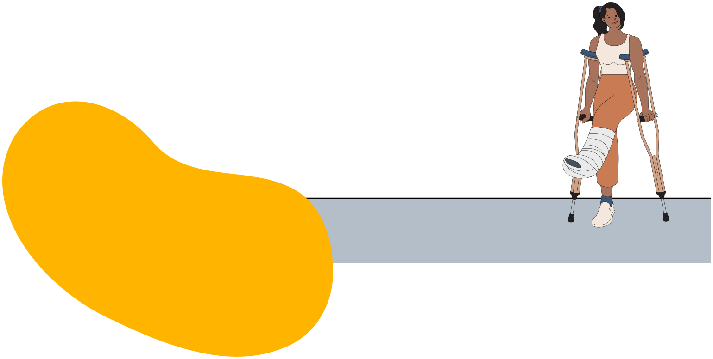
What is a
disability?
Disabilities may be visible or
invisible and can limit
physical, mental, sensory, or
cognitive abilities, including
mobility, developmental,
sensory, or mental health disorders.

Slide 5
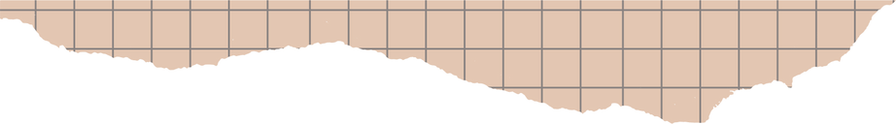

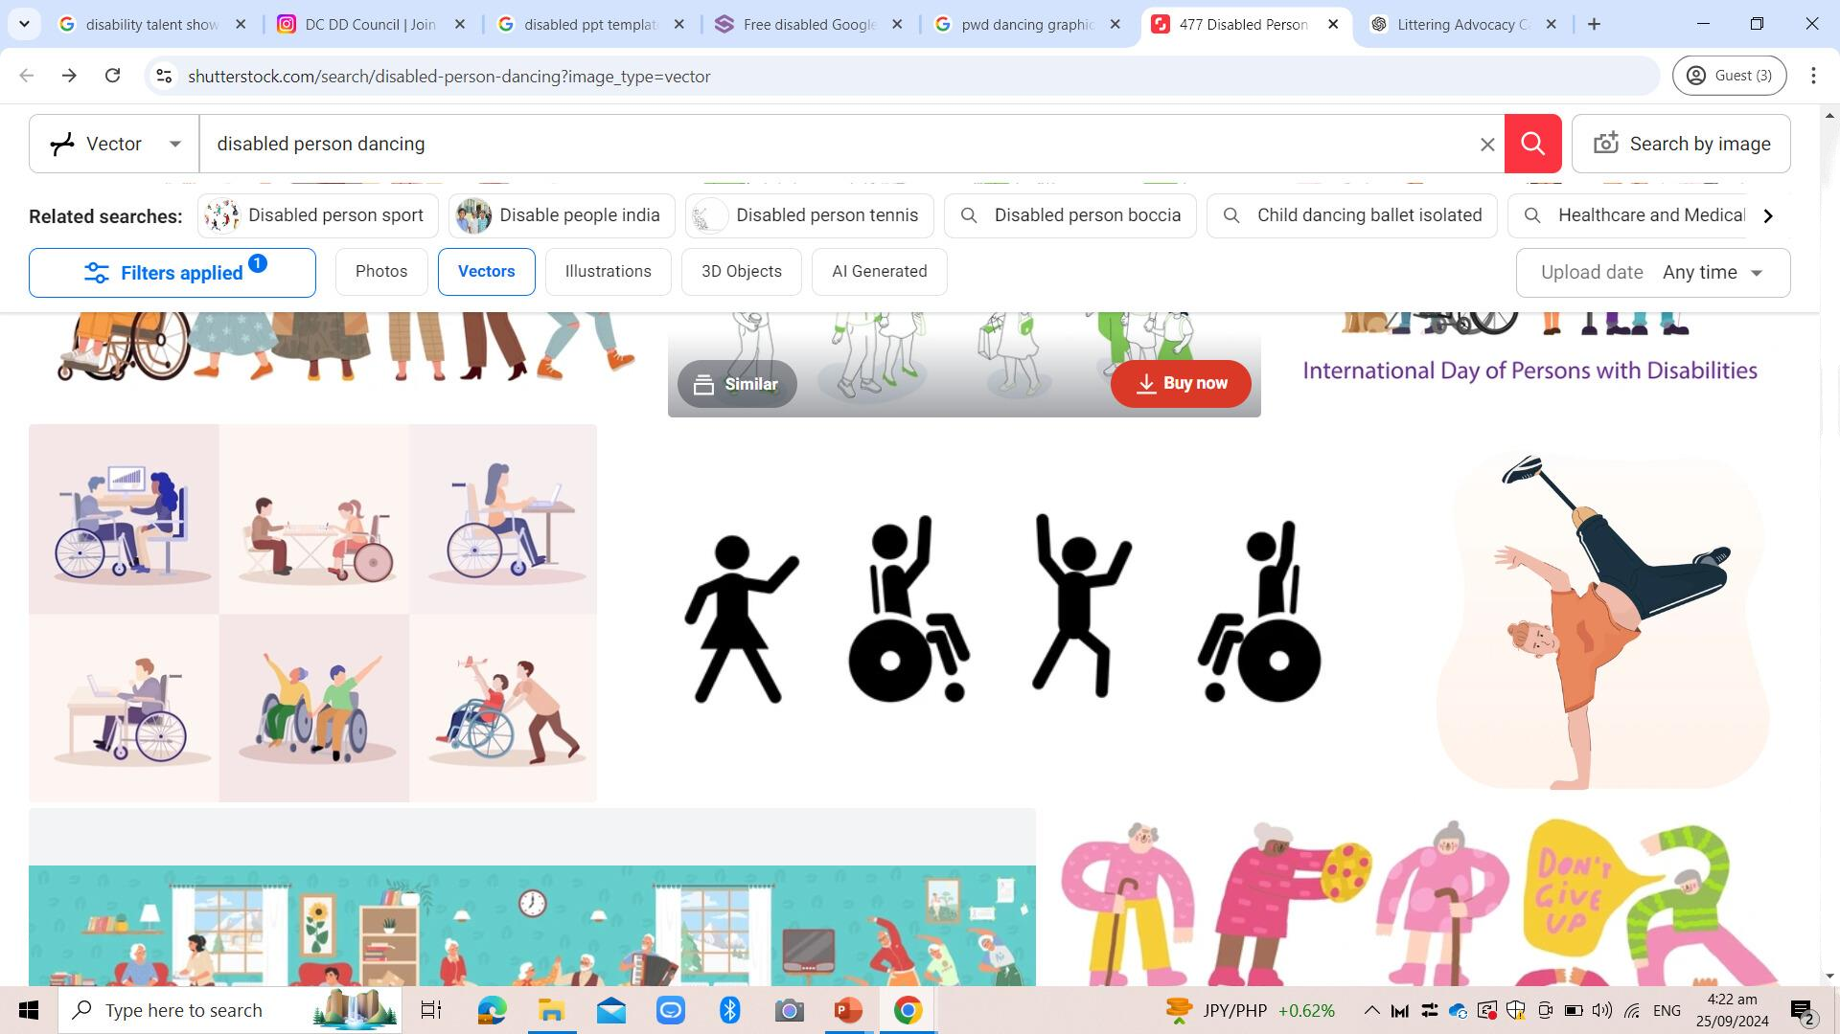
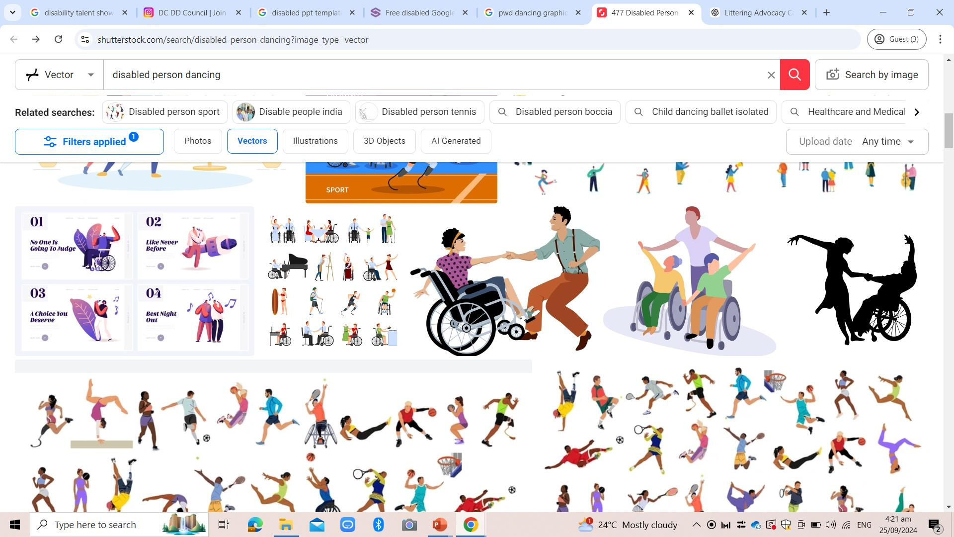

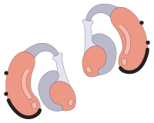
About
The talent show showcases artistic and creative performances by individuals with disabilities, including singing, dancing, and spoken word poetry. The event promotes teamwork through collaborative performances and demonstrates how adaptive technologies help individuals fully
express their talents.

Slide 6
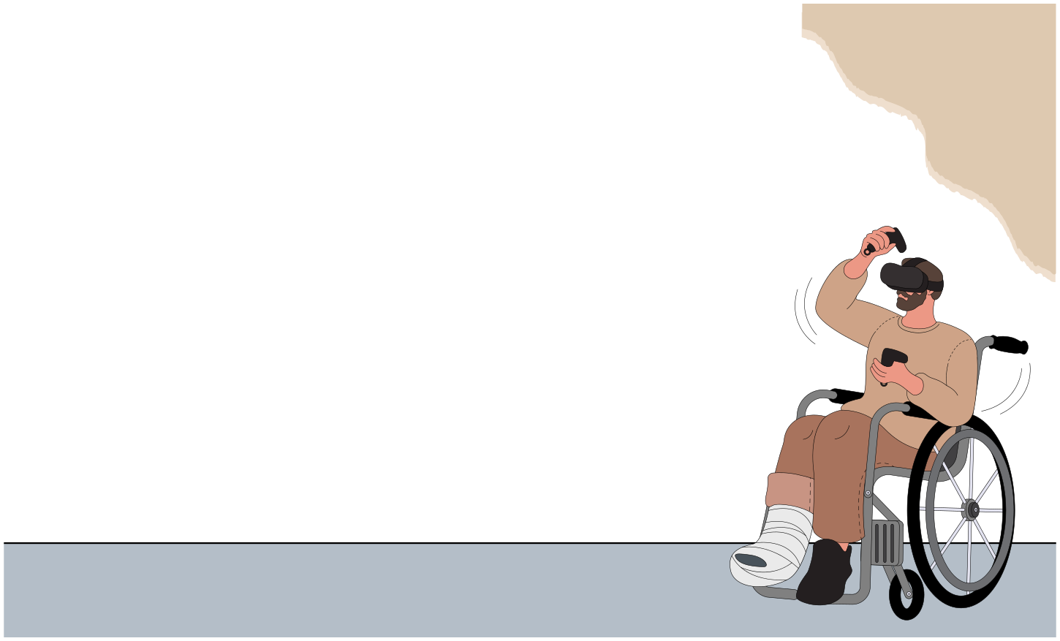



Benefits
The talent show fosters inclusion, raises
disability awareness, and empowers participants by providing a platform for
creative expression. It also inspires the community to rethink perceptions of
disability, promoting a stronger, more
inclusive society.

Slide 7
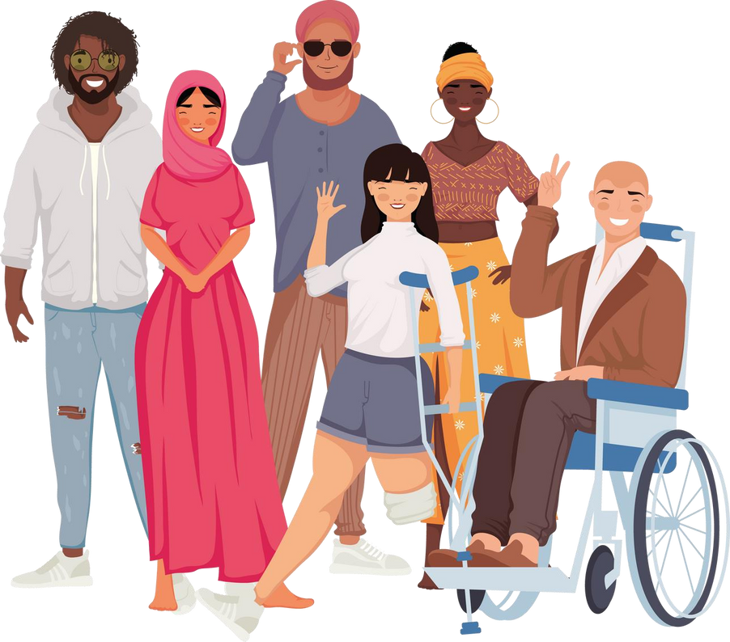
Call for Action
The campaign invites community members to participate by attending, supporting, or sharing the event. By promoting the message of inclusion and celebrating the talents of individuals with disabilities, everyone can help create a more accepting and accessible community.

Slide 8

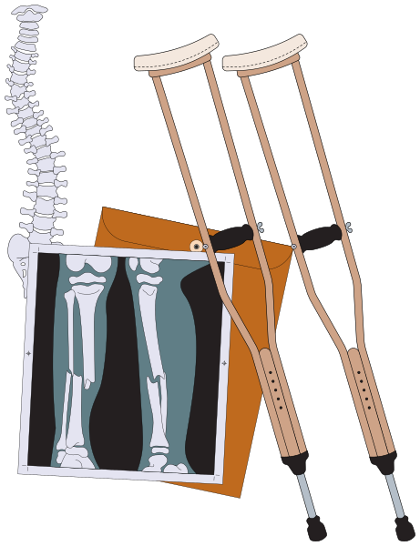

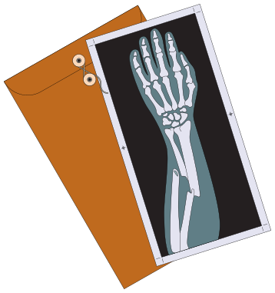
Thank you
for listening!
More info.
Table of Contents
Table of Contents

